Slide 1
Access Control
CT1405 Lecture 7

Slide 2
Objectives
Define access control and list the four access control models
Describe logical access control methods
Explain the different types of physical access control
Define authentication services

Slide 3
Introduction
Important foundations in information security
  Verifying approved users
  Controlling their access
This chapter introduces principles and practices of controlling access
  Terminology
  Four standard control models
  Best practices
Authentication services is also covered in this chapter

Slide 4
What Is Access Control?
Granting or denying approval to use specific resources
Information system’s mechanism to allow or restrict access to data or devices
Four standard models
Specific practices used to enforce access control

Slide 5
Access Control Terminology
Identification
  Presenting credentials
  Example: delivery driver presenting employee badge
Authentication
  Checking the credentials
  Example: examining the delivery driver’s badge
Authorization
  Granting permission to take action
  Example: allowing delivery driver to pick up package

Slide 6
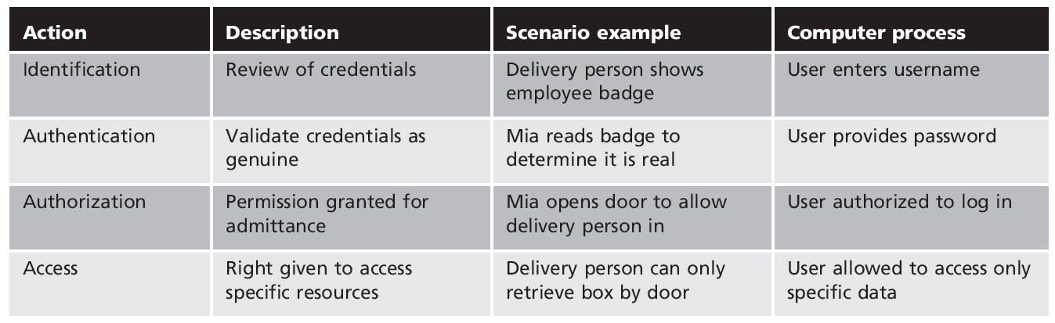
Table 9-1 Basic steps in access control

Slide 7
Access Control Terminology (cont’d.)
Object
  Specific resource
  Example: file or hardware device
Subject
  User or process functioning on behalf of a user
  Example: computer user
Operation
  Action taken by the subject over an object
  Example: deleting a file

Slide 8
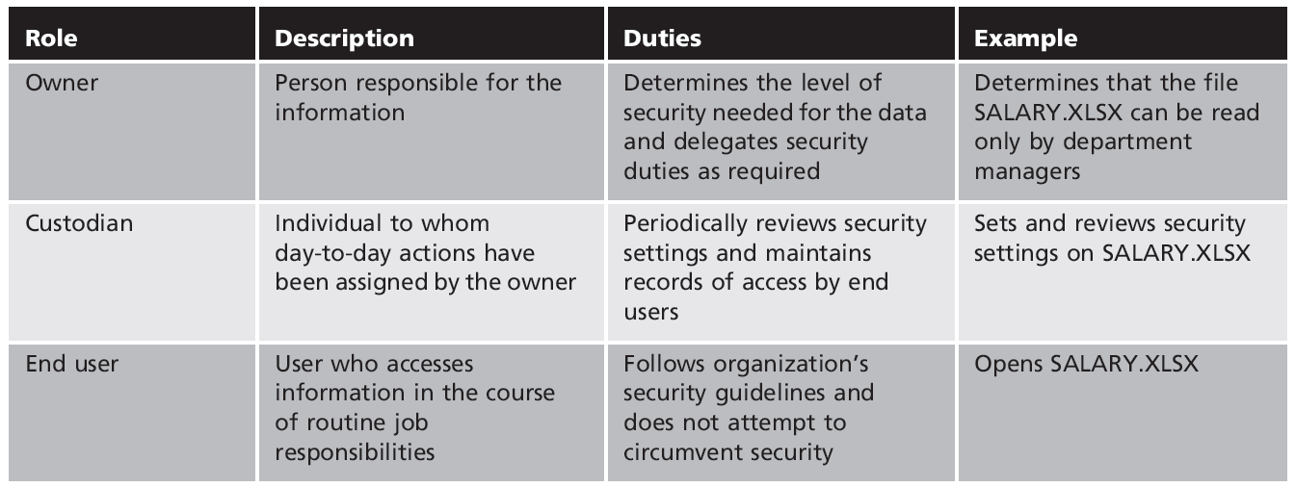
Table 9-2 Roles in access control

Slide 9
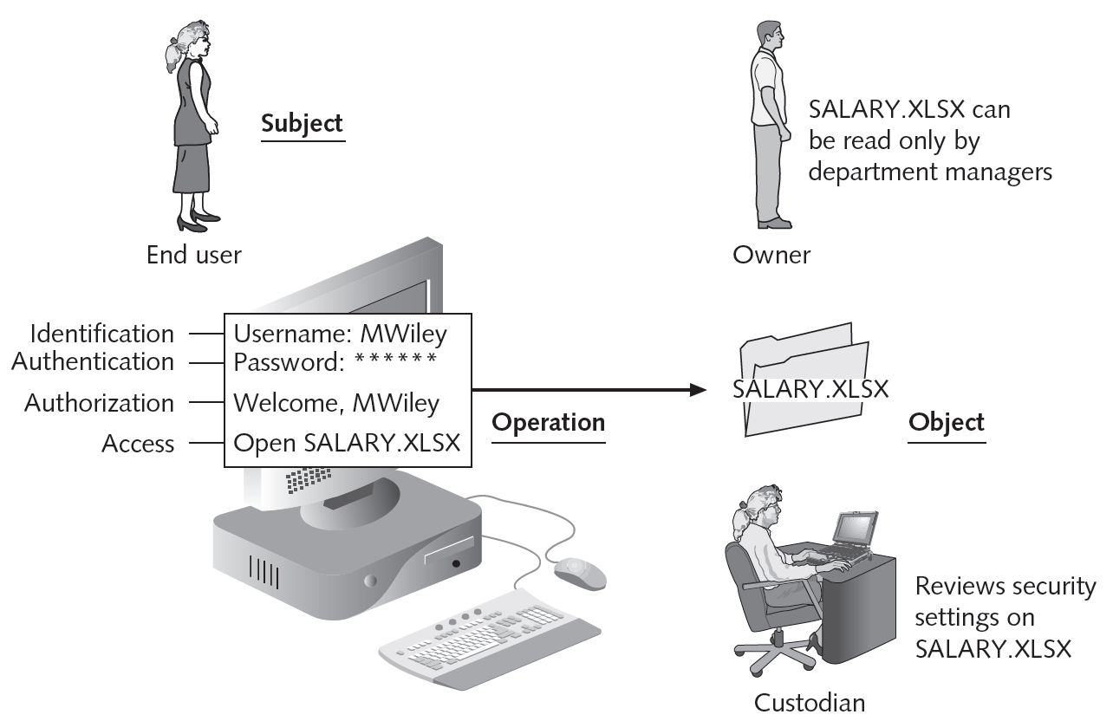
Figure 9-1 Access control process and terminology
© Cengage Learning 2012

Slide 10
Access Control Models
Standards that provide a predefined framework for hardware or software developers
Used to implement access control in a device or application
Custodians can configure security based on owner’s requirements
Four major access control models
  Mandatory Access Control (MAC)
  Discretionary Access Control (DAC)

Slide 11
Access Control Models (cont’d.)
Four major access control models (cont’d.)
  Role Based Access Control (RBAC)
  Rule Based Access Control (RBAC)
Mandatory Access Control
  Most restrictive access control model
  Typically found in military settings
  Two elements
    Labels
    Levels

Slide 12
Access Control Models (cont’d.)
MAC grants permissions by matching object labels with subject labels
  Labels indicate level of privilege
To determine if file may be opened:
  Compare object and subject labels
  Subject must have equal or greater level than object to be granted access
Two major implementations of MAC
  Lattice model
  Bell-LaPadula model

Slide 13
Access Control Models (cont’d.)
Lattice model
  Subjects and objects are assigned a “rung” on the lattice
  Multiple lattices can be placed beside each other
Bell-LaPadula
  Similar to lattice model
  Subjects may not create a new object or perform specific functions on lower level objects

Slide 14
Access Control Models (cont’d.)
Example of MAC implementation
  Windows 7/Vista has four security levels
  Specific actions by a subject with lower classification require administrator approval
Discretionary Access Control (DAC)
  Least restrictive model
  Every object has an owner
  Owners have total control over their objects
  Owners can give permissions to other subjects over their objects

Slide 15
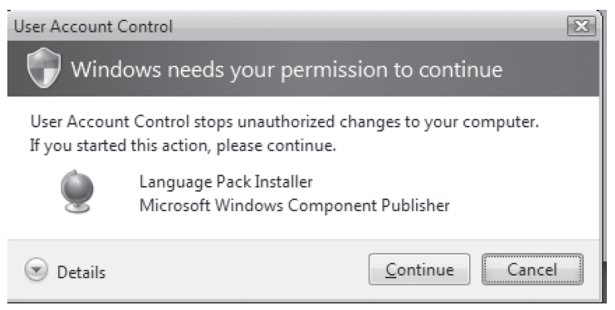
Figure 9-2 Windows User Account Control (UAC) dialog box
© Cengage Learning 2012

Slide 16
Access Control Models (cont’d.)
Discretionary Access Control (cont’d.)
  Used on operating systems such as most types of UNIX and Microsoft Windows
DAC weaknesses
  Relies on decisions by end user to set proper security level
    Incorrect permissions may be granted
  Subject’s permissions will be “inherited” by any programs the subject executes
  Trojans are a particular problem with DAC

Slide 17
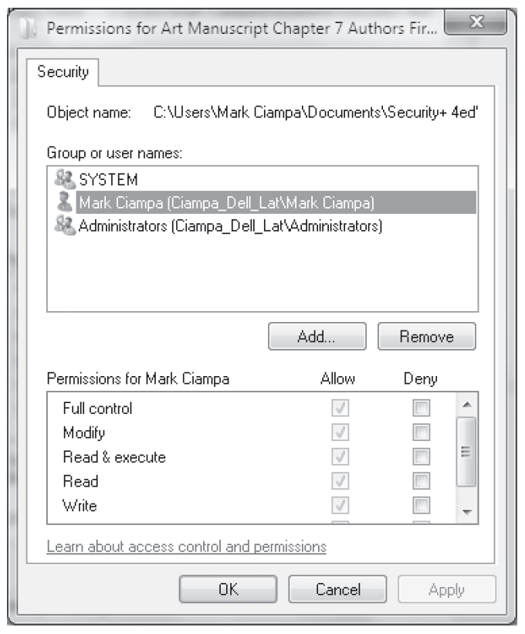
Figure 9-3 Discretionary Access Control (DAC)
© Cengage Learning 2012

Slide 18
Access Control Models (cont’d.)
Role Based Access Control (RBAC)
  Also called Non-discretionary Access Control
  Access permissions are based on user’s job function
RBAC assigns permissions to particular roles in an organization
  Users are assigned to those roles
Rule Based Access Control (RBAC)
  Dynamically assigns roles to subjects based on a set of rules defined by a custodian

Slide 19
Access Control Models (cont’d.)
Rule Based Access Control (cont’d.)
  Each resource object contains access properties based on the rules
  When user attempts access, system checks object’s rules to determine access permission
  Often used for managing user access to one or more systems
    Business changes may trigger application of the rules specifying access changes

Slide 20
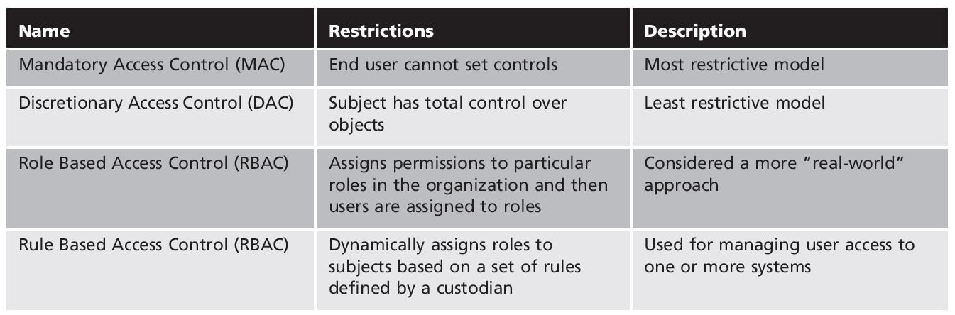
Table 9-3 Access control models

Slide 21
Best Practices for Access Control
Establishing best practices for limiting access
  Can help secure systems and data
Examples of best practices
  Separation of duties
  Job rotation
  Least privilege
  Implicit deny
  Mandatory vacations

Slide 22
Best Practices for Access Control (cont’d.)
Separation of duties
  Fraud can result from single user being trusted with complete control of a process
  Requiring two or more people responsible for functions related to handling money
  System is not vulnerable to actions of a single person
Job rotation
  Individuals periodically moved between job responsibilities

Slide 23
Best Practices for Access Control (cont’d.)
Job rotation (cont’d.)
  Employees can rotate within their department or across departments
Advantages of job rotation
  Limits amount of time individuals are in a position to manipulate security configurations
  Helps expose potential avenues for fraud
    Individuals have different perspectives and may uncover vulnerabilities
  Reduces employee burnout

Slide 24
Best Practices for Access Control (cont’d.)
Least privilege
  Limiting access to information based on what is needed to perform a job function
  Helps reduce attack surface by eliminating unnecessary privileges
  Should apply to users and processes on the system
  Processes should run at minimum security level needed to correctly function
  Temptation to assign higher levels of privilege is great

Slide 25
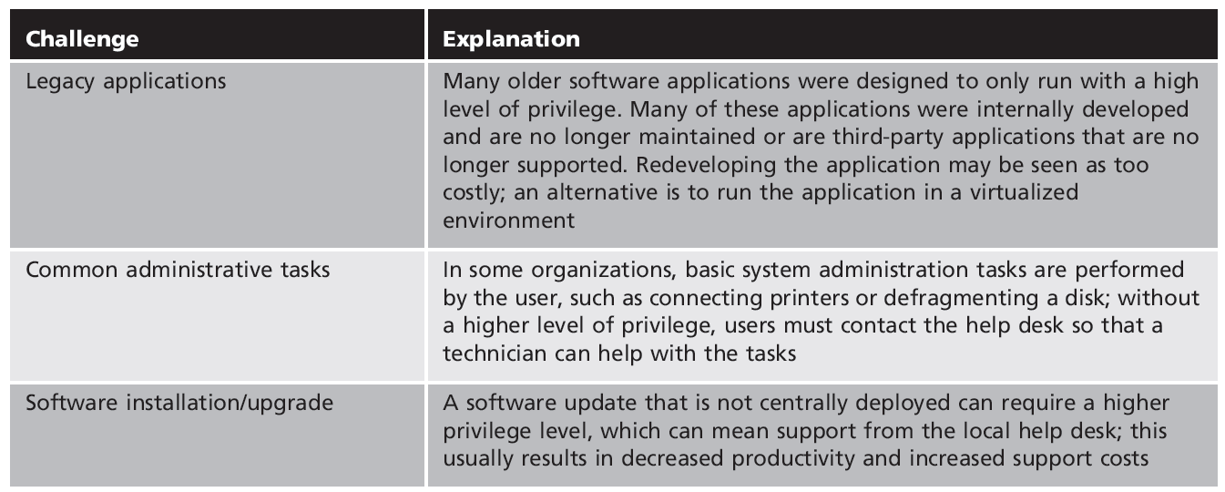
Table 9-4 Challenges of least privilege

Slide 26
Best Practices for Access Control (cont’d.)
Implicit deny
  If a condition is not explicitly met, access request is rejected
  Example: network router rejects access to all except conditions matching the rule restrictions
Mandatory vacations
  Limits fraud, because perpetrator must be present daily to hide fraudulent actions
  Audit of employee’s activities usually scheduled during vacation for sensitive positions

Slide 27
Access Control Lists
Set of permissions attached to an object
Specifies which subjects may access the object and what operations they can perform
When subject requests to perform an operation:
  System checks ACL for an approved entry
ACLs usually viewed in relation to operating system files

Slide 28
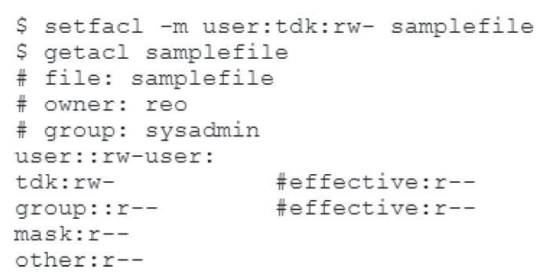
Figure 9-4 UNIX file permissions
© Cengage Learning 2012

Slide 29
Access Control Lists (cont’d.)
Each entry in the ACL table is called access control entry (ACE)
ACE structure (Windows)
  Security identifier for the user or group account or logon session
  Access mask that specifies access rights controlled by ACE
  Flag that indicates type of ACE
  Set of flags that determine whether objects can inherit permissions

Slide 30
Group Policies
Microsoft Windows feature
  Provides centralized management and configuration of computers and remote users using Active Directory (AD)
  Usually used in enterprise environments
  Settings stored in Group Policy Objects (GPOs)
Local Group Policy
  Fewer options than a Group Policy
  Used to configure settings for systems not part of AD

Slide 31
Account Restrictions
Time of day restrictions
  Limits the time of day a user may log onto a system
  Time blocks for permitted access are chosen
  Can be set on individual systems
Account expiration
  Orphaned accounts: accounts that remain active after an employee has left the organization
  Dormant accounts: not accessed for a lengthy period of time
  Both can be security risks

Slide 32
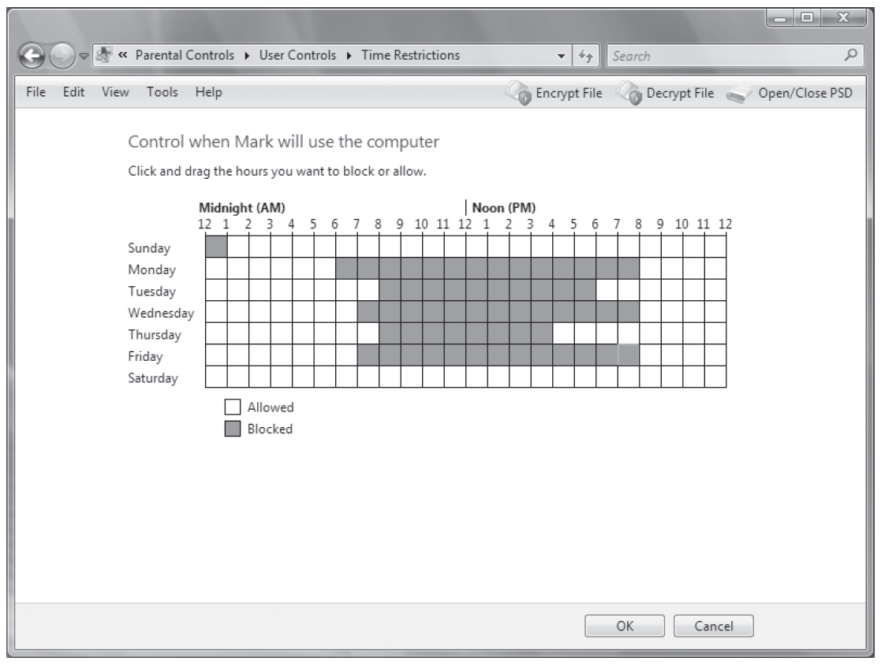
Figure 9-5 Operating system time of day restrictions
© Cengage Learning 2012

Slide 33
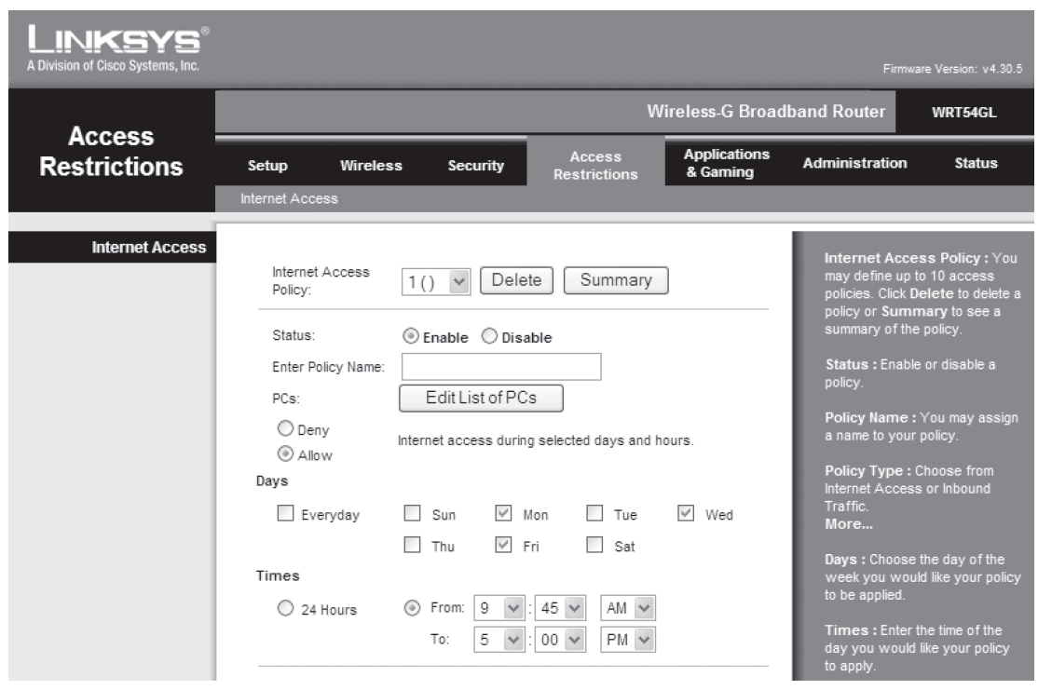
Figure 9-6 Wireless access point restrictions
© Cengage Learning 2012

Slide 34
Account Restrictions (cont’d.)
Recommendations for dealing with orphaned or dormant accounts
  Establish a formal process
  Terminate access immediately
  Monitor logs
Orphaned accounts remain a problem in today’s organizations
Account expiration
  Sets a user’s account to expire

Slide 35
Account Restrictions (cont’d.)
Password expiration sets a time when user must create a new password
  Different from account expiration
Account expiration can be a set date, or a number of days of inactivity

Slide 36
Authentication Services
Authentication
  Process of verifying credentials
Authentication services provided on a network
  Dedicated authentication server
    Or AAA server if it also performs authorization and accounting
Common types of authentication and AAA servers
  Kerberos, RADIUS, TACACS, LDAP

Slide 37
RADIUS
Remote Authentication Dial In User Service
  Developed in 1992
  Became industry standard
  Suitable for high volume service control applications
    Such as dial-in access to corporate network
  Still in use today
RADIUS client
  Typically a device such as a wireless AP
    Responsible for sending user credentials and connection parameters to the RADIUS server

Slide 38
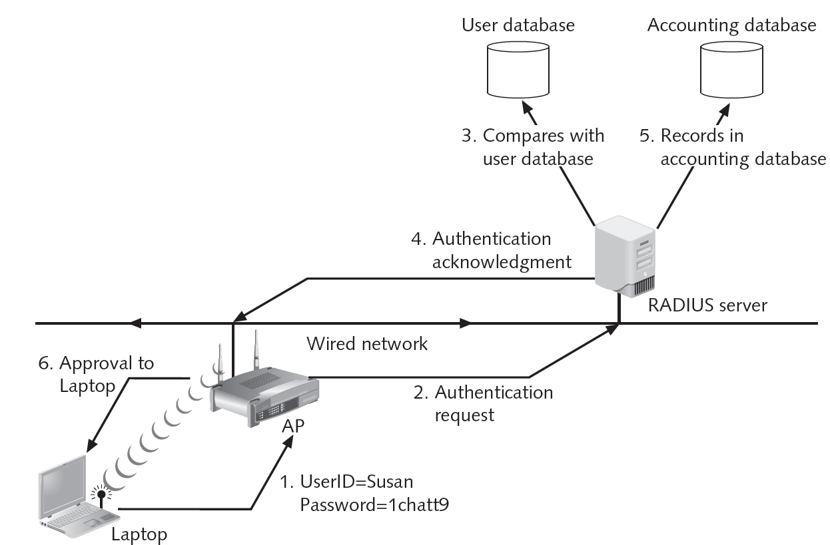
Figure 9-7 RADIUS authentication
© Cengage Learning 2012

Slide 39
RADIUS (cont’d.)
RADIUS user profiles stored in central database
  All remote servers can share
Advantages of a central service
  Increases security due to a single administered network point
  Easier to track usage for billing and keeping network statistics

Slide 40
Kerberos
Authentication system developed at MIT
  Uses encryption and authentication for security
Most often used in educational and government settings
Works like using a driver’s license to cash a check
Kerberos ticket
  Contains information linking it to the user
  User presents ticket to network for a service
  Difficult to copy
  Expires after a few hours or a day

Slide 41
Terminal Access Control Access Control System (TACACS)
Authentication service similar to RADIUS
Developed by Cisco Systems
Commonly used on UNIX devices
Communicates by forwarding user authentication information to a centralized server

Slide 42
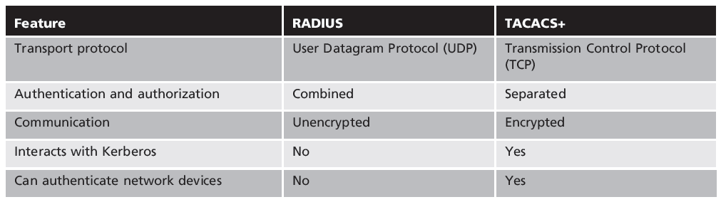
Table 9-5 Comparison of RADIUS and TACACS+

Slide 43
Lightweight Directory Access Protocol (LDAP)
Directory service
  Database stored on a network
  Contains information about users and network devices
  Keeps track of network resources and user’s privileges to those resources
  Grants or denies access based on its information
Standard for directory services
  X.500

Slide 44
Lightweight Directory Access Protocol (cont’d.)
X.500 standard defines protocol for client application to access the DAP
LDAP
  A simpler subset of DAP
  Designed to run over TCP/IP
  Has simpler functions
  Encodes protocol elements in simpler way than X.500
  An open protocol

Slide 45
Lightweight Directory Access Protocol (cont’d.)
Weakness of LDAP
  Can be subject to LDAP injection attacks
    Similar to SQL injection attacks
    Occurs when user input is not properly filtered

Slide 46
Summary
Access control is the process by which resources or services are denied or granted
Four major access control models exist
Best practices for implementing access control
  Separation of duties
  Job rotation
  Least privilege
  Mandatory vacations

Slide 47
Summary (cont’d.)
Access control lists define which subjects are allowed to access which objects
  Specify which operations they may perform
Group Policy is a Windows feature that provides centralized management and configuration
Authentication services can be provided on a network by a dedicated AAA or authentication server
  RADIUS is the industry standard

